Slide 1

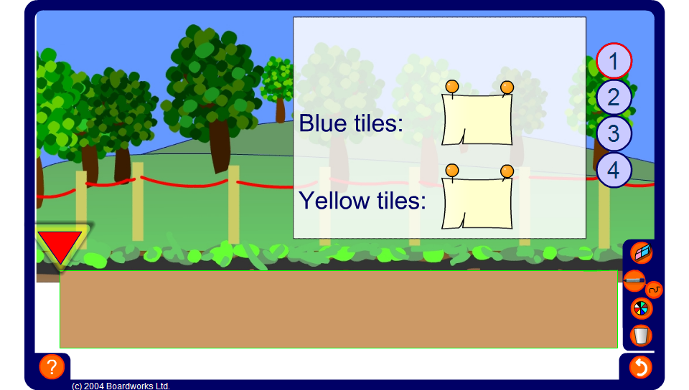


Paving slabs 1
Notes:
Explain that a gardener is experimenting with different patterns for a path. Start by investigating pattern 1 by dragging the arrow and revealing the number of blue and yellow tiles.
Ask, Can you spot any patterns?
Establish that for this pattern there are 8 blue tiles for every yellow tile. We can therefore find the number of blue tiles by multiplying the number of yellow tiles by 8.

